Slide 1
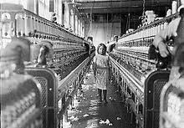
The Industrialisation of America
Unit 2A

Slide 2
Task
Think about what you would expect the blessings and curses of industrialisation to be. Make a list, using your knowledge of the impact of industrialisation in Britain or other countries.

Slide 3
VOCABULARY
Capital – Wealth acquired in business by an individual or company that is used to create more wealth.
Capitalists – Business magnates who have created enormous capital through exploitative business practices.
Consumerism – The desire to acquire luxury goods and leisure services.

Slide 4
Industrialisation – The movement from agriculture to manufacturing as the main source of economic growth.
Trust – A combination of companies brought together by magnates to reduce competition within an industry.
Union – An organisation representing the worker’s interests for the purpose of securing improved wages, a reduction in working hours and safer working conditions – in other words in an attempt to regulate the exploitative activities of capitalists

Slide 5
Causes of Industrialisation
The Civil War created the demand for guns, ammunition, rail lines, uniforms etc etc, quickly and in great demand.
When the war ended in 1865 industrial production kept on growing fueled by America’s increasing, and increasingly urban-based, population.
Such growth brought immense wealth to some and desperate poverty.

Slide 6
America’s unique advantages.
A strong transport system
Unified, peaceful nation
A nation without external enemies
Large scale immigration, providing new workers and new consumers.
Extensive sources of raw material. E.G gold, iron ore, oil, timber.
A growing demand for goods from a young population

Slide 7
The Gilded Age
The writer Mark Twain called the late 1800’s ‘the Gilded Age’. It was an age when great wealth was created usually from mineral wealth which was converted by business magnates to financial, manufacturing or industrial wealth.
The key areas of industrial growth were oil, iron, steel, railroads.
Rapid industrial was propelled by the electrification of industries, transportation, housing and factories.

Slide 8
Industrial growth
From the 1880’s manufacturing overtook agriculture as the most important industry in the US.
The law making process was compromised by a plutocracy, rule by the rich.
Many of the senators were millionaires who had made their fortune in mining, retail, transportation or manufacturing.
Donations to political parties by business magnates to ensure favourable laws and regulations increased as a result of the excesses of the “Gilded Age”.
Such an undemocratic system became a target for social progressives.

Slide 9
Trusts & business magnates
Trusts were in effect combinations of corporations that had a monopoly in a particular market.
By combining their industrial strength, the trustees centralised control of production, patents and capital.
By 1901 J.P Morgan’s steel trust controlled 60% of the United States’ steel industry.
In 1901 Morgan employed 168,000 steelworkers, who worked 12 hours a day in dangerous factories.

Slide 10
They had very little bargaining power, because;
The work required unskilled labour.
There was a lack of education and high illiteracy among steelworkers.
American workers in the new industrial society were slow to unionise.
New workers were available at low rates of pay as a result of high immigration.
The federal government had encouraged industrialisation.
There was little legislative protection of wages and conditions.

Slide 11
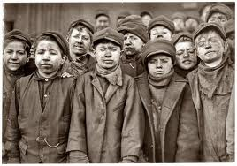

Slide 12
Trust-busting
The federal government had previously protected the industrialists in an attempt to stimulate economic growth.
In 1902 Theodore Roosevelt decided to attack the trusts and regulate them .
He became known as the ‘trust-buster’ as he took on the powerful and influential business magnates and their political allies.
He called for a ‘square deal’ for the American workers and consumers and rallied against the excesses of the business magnates.

Slide 13
The Progressive Era 1890-1917
New focus on the rights of the workers, regulation of business and social justice. The success of the progressives include;
10 hour working day
Establishment of US Department of Commerce in 1903 to investigate corporate behaviour.
The Hepburn Act (1906) which regulated the price the fees railroads could charge.
The end of child labour exploitation.
The promotion of African-American rights to equal employment, education and housing
Increasing women’s suffrage and women’s rights

Slide 14
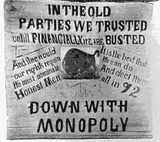
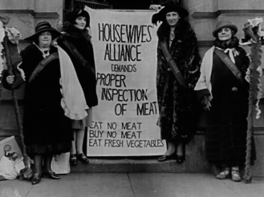

Slide 15
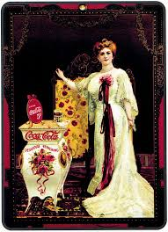
Consumerism
The effects of the rise of consumerism in American society were profound.
Rise of new products.
The Teddy Bear, named after Theodore ‘Teddy’ Roosevelt.
Bicycles
Pianos
Corsets, lingerie and perfume.
Snack food, chewing gum (Wrigleys) and cigarettes.
Soda pop (Coca-Cola)
Cars (Ford’s Model T)
Early 20th Century Coca-Cola poster.

Slide 16
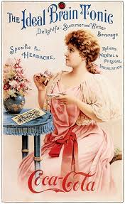
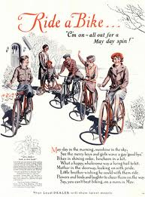
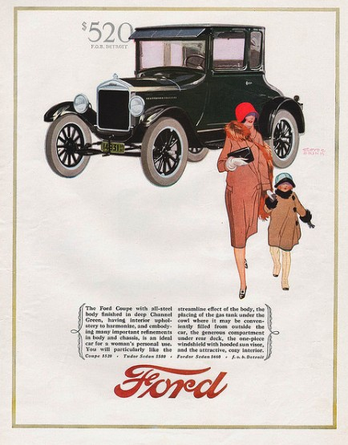
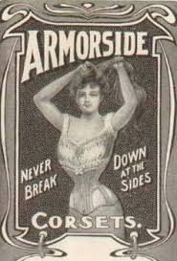
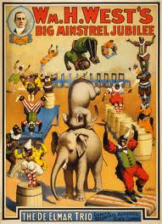

Slide 17
Leisure
With the regularity of factory life and increasing urbanisation came the need for leisure activities.
Sport, music and spectator leisure became important features of the US consumer society from 1898.
Spectators attended professional baseball and football games, horseracing and boxing.
Vaudeville acts and the cinema were attended at least once a week.
Advertising became increasingly sexualised and women were targeted as consumers of items such as chest developers.

Slide 18
Henry Ford & the Model T
TASK 1: Read pp 29-32 of the textbook.
TASK 2: Answer questions 1-8.
FOCUS QUESTION: Was industrialisation a blessing or a blight for the USA? Explain why in one paragraph.

